Slide 1

Intro to APIs
Please connect to “muguest” wifi and accept the terms.
Goto: https://github.com/LauraBiss/apis_materials
Download the class materials and extract the files to your computer.
GDI Boise

Slide 2

Client Side APIs
What
Why
How

Slide 3
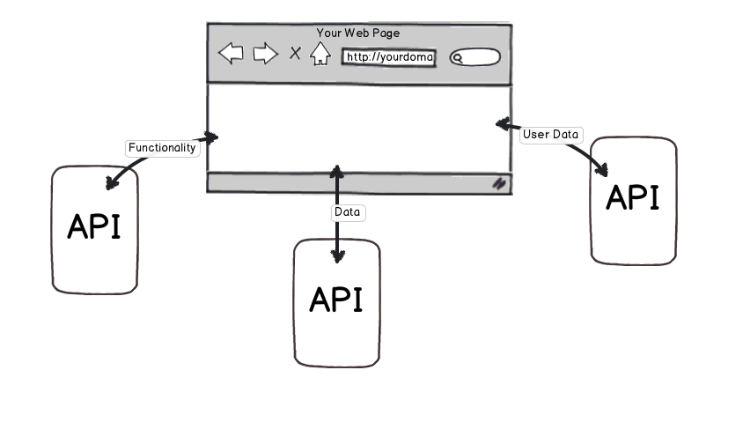
What is a web API?
Application Programming Interface

Slide 4
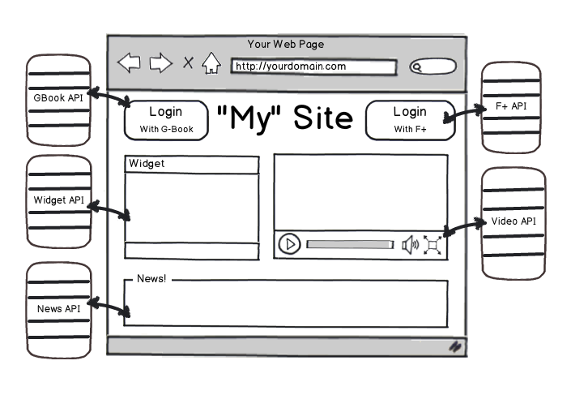
Why: Client Side APIs

Slide 5
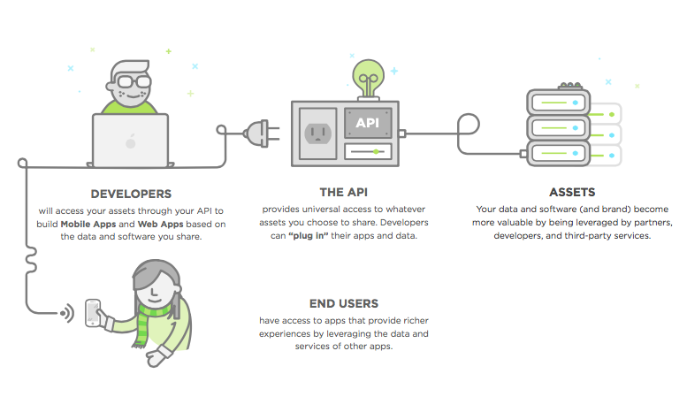
Client Side APIs: HOW

Slide 6
Exercise One: HTML APIs
In this exercise, you'll try out using several HTML APIs to add more dynamic content to the starter webpage.
Open the ExerciseOneStarter.html file. Open the webpage up in the browser and make sure it works. It should pull in video information from inline JSON data and display linked video thumbnails in a list.
Add a counter: Go to flagcounter.com and set up a hit counter for your website. Put the counter somewhere near the bottom of the page within a div using id=“counter”.

Slide 7
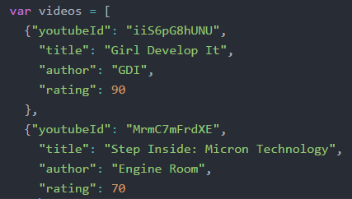

Rating Chart
Step 1: Add a "rating" field to each video in the inline JSON data.
Step 2: Go to the Google Gauge Charts API Docs and read about the Gauge Chart API parameters.
Step 3: Open the link to the JSFiddle example and notice the HTML portion is segregated from the JavaScript portion.

Slide 8
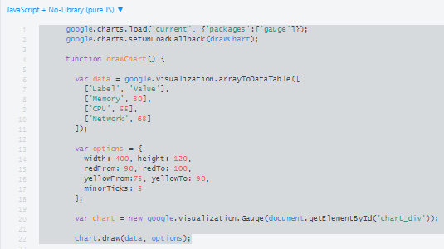
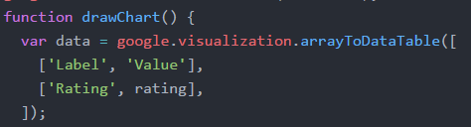
Add Rating Chart Continued…
Step 4: From the top of the JavaScript portion, copy the contents until you reach the “setInterval” function (lines 1-22). Place the
copied code within script tags at the bottom of the page
before the ending body tag.
Step 5: Rename the section titled “Memory” to “Rating”
and delete CPU and Network. Change the hard coded
rating field to use a variable called “rating”.
Step 6: Add the loader.js script to the header of the webpage and the chart div to the body of the webpage.

Slide 9
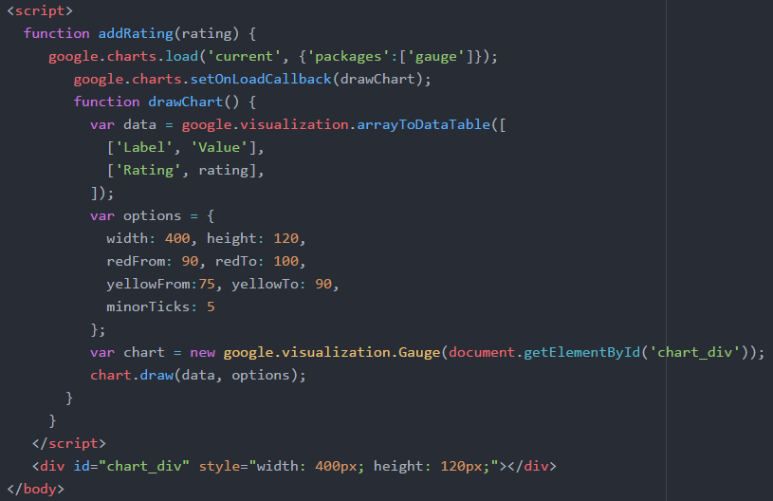
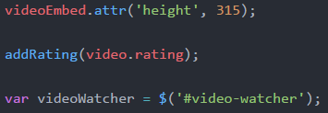
Add Rating Chart Continued…
Step 7: Nest previously added JavaScript code within a function called “addRating” that accepts a variable called “rating” and assigns this variable to the rating field.
Step 8: Call the addRating function within the addVideoToList function.
Step 9: Save and test the web page. Click on the videos to test the new gauge chart. If it isn’t working open the console to check for errors.

Slide 10
Quick Break

Slide 11
Astronomy Picture of the Day
Visit NASA’s popular site at: https://api.nasa.gov/api.html#apod
This site loads in a different picture or video every day and provides an API for those who would like to retrieve the picture and associated information.
Sign up for the NASA Developer API key.
Copy the key you are assigned after signing up.
Open the apodStarter.html file in an editor.

Slide 12

Exercise Two: APOD
Replace the DEMO_KEY with your key (line 34).
Refresh the page and ensure it works.
Check console for errors if it isn’t working.
Change the date and refresh the page. Notice the picture and information change.

Slide 13
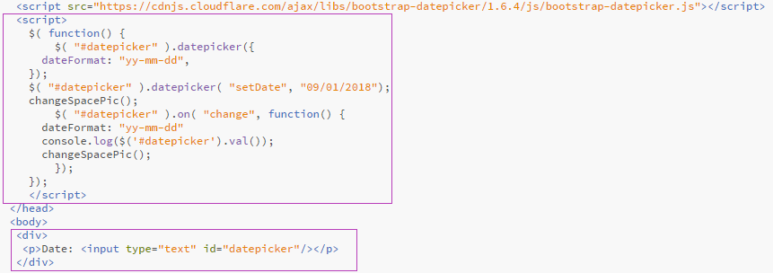
Exercise Two: APOD
In the header add the datepicker function.
In the body add a div, a paragraph and an input for datepicker.

Slide 14
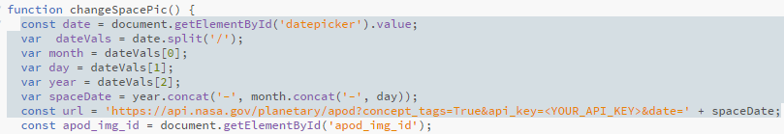
Exercise Two: APOD
Add JavaScript to format the date from datepicker and assign it to the variable “spaceDate”.
Append the url variable with “&date=‘ + spaceDate”

Slide 15
Extra Time?
Try working with the Marvel API!
Register for a Marvel API key.
Use the marvel.html as a starter file.
Explore the interactive API documentation using their website.

